Slide 1
6. Write a Servlet to demonstrate session tracking using HttpSession.
Implement a simple login system where the user&#39;s session is tracked.
AIM
To create a web application that demonstrates session tracking using the HttpSession interface. The application will maintain a user's login state across multiple pages of the Weather Information portal.
ALGORITHM
Input: The user enters their credentials on the login page.
Session Creation:
Upon successful authentication, the Servlet creates a session using request.getSession().
The user's identity is stored as a session attribute (e.g., session.setAttribute("user", name)).
Session Tracking:
When the user navigates to the Weather Dashboard, the Servlet checks if a valid session exists.
If session.getAttribute("user") is not null, the dashboard is displayed; otherwise, the
user is redirected to the login page.
Session Termination: A "Logout" button is provided to invalidate the session using
session.invalidate(), ensuring the user is logged out.
Deployment: Compile the Servlet, map it in the web.xml or via annotations, and deploy it to Apache Tomcat.
SOURCE CODE
A. HTML File (index.html)
This file provides the login interface for the weather portal. HTML
<!DOCTYPE html>
<html>
<head>
<title>Weather Portal | Login</title>
<style>
body { font-family: 'Segoe UI', sans-serif; background: #f0f2f5; display: flex; justify-content: center; align-items: center; height: 100vh; margin: 0; }
.login-card { background: white; padding: 30px; border-radius: 12px; box-
shadow: 0 4px 12px rgba(0,0,0,0.1); width: 300px; text-align: center; }
input { width: 100%; padding: 10px; margin: 10px 0; border: 1px solid #ddd; border-radius: 6px; box-sizing: border-box; }
.btn { width: 100%; padding: 10px; background: #007bff; color: white; border:
none; border-radius: 6px; cursor: pointer; }
</style>
</head>
<body>
<div class="login-card">
<h2>🌤 Weather Login</h2>
<form action="SessionServlet" method="POST">
<input type="text" name="name" placeholder="Username" required>
<input type="password" name="password" placeholder="Password" required>

Slide 2
<input type="submit" class="btn" value="Login">
</form>
</div>
</body>
</html>
Java File (SessionServlet.java)
This Servlet manages the session creation and the weather dashboard.
Java
import java.io.*;
import jakarta.servlet.*; import jakarta.servlet.http.*;
import jakarta.servlet.annotation.WebServlet;
@WebServlet("/SessionServlet")
public class SessionServlet extends HttpServlet {
protected void doPost(HttpServletRequest request, HttpServletResponse response) throws ServletException, IOException {
response.setContentType("text/html");
PrintWriter out = response.getWriter();
String name = request.getParameter("name"); String pass = request.getParameter("password");
if(pass.equals("admin123")) {
// Create a session and store user info HttpSession session = request.getSession(); session.setAttribute("user", name); response.sendRedirect("DashboardServlet");
} else {
out.print("<p style='color:red'>Invalid Password!</p>"); request.getRequestDispatcher("index.html").include(request, response);
}
}
}
Java File (DashboardServlet.java)
This Servlet verifies the session before showing weather data.
Java
@WebServlet("/DashboardServlet")
public class DashboardServlet extends HttpServlet {
protected void doGet(HttpServletRequest request, HttpServletResponse response) throws ServletException, IOException {
response.setContentType("text/html");
PrintWriter out = response.getWriter();
HttpSession session = request.getSession(false);
if (session != null && session.getAttribute("user") != null) { String name = (String) session.getAttribute("user");
out.println("<body style='text-align:center; padding-top:50px;'>");
out.println("<h1>Welcome to Weather Dashboard, " + name + "!</h1>");
out.println("<p>Current Weather: 25°C Sunny ●</p>"); out.println("<a href='LogoutServlet'>Logout</a>"); out.println("</body>");
} else {
out.print("Please login first!"); request.getRequestDispatcher("index.html").include(request, response);
}
}
}

Slide 3
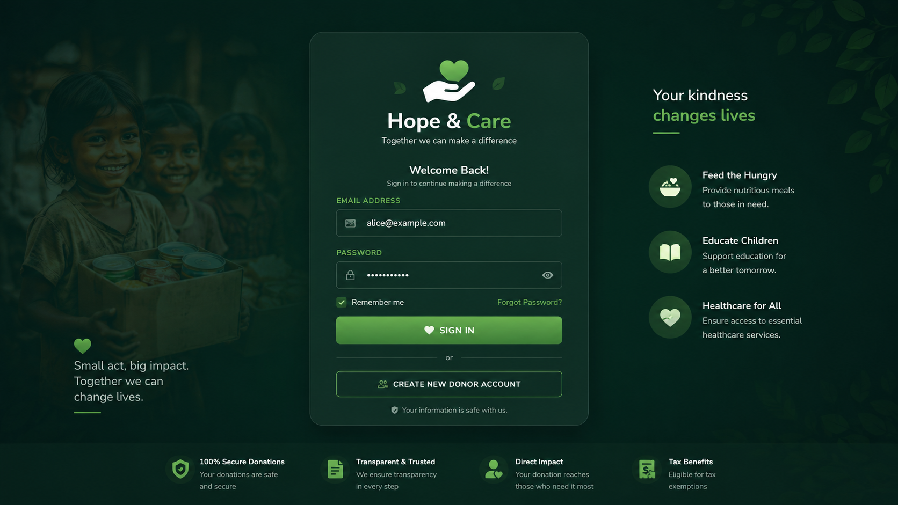
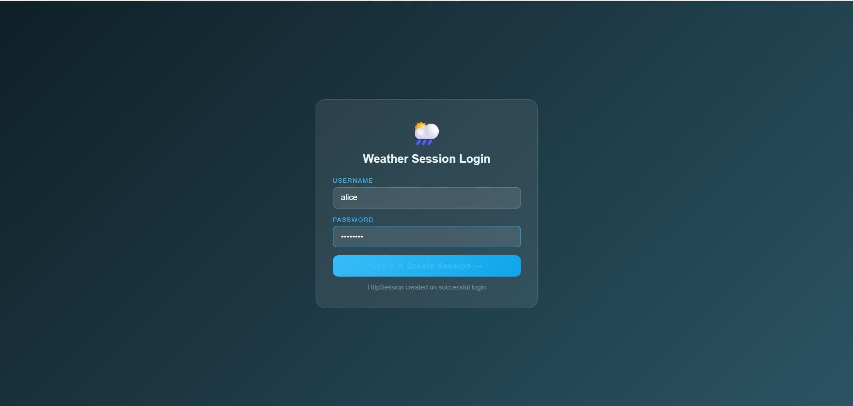
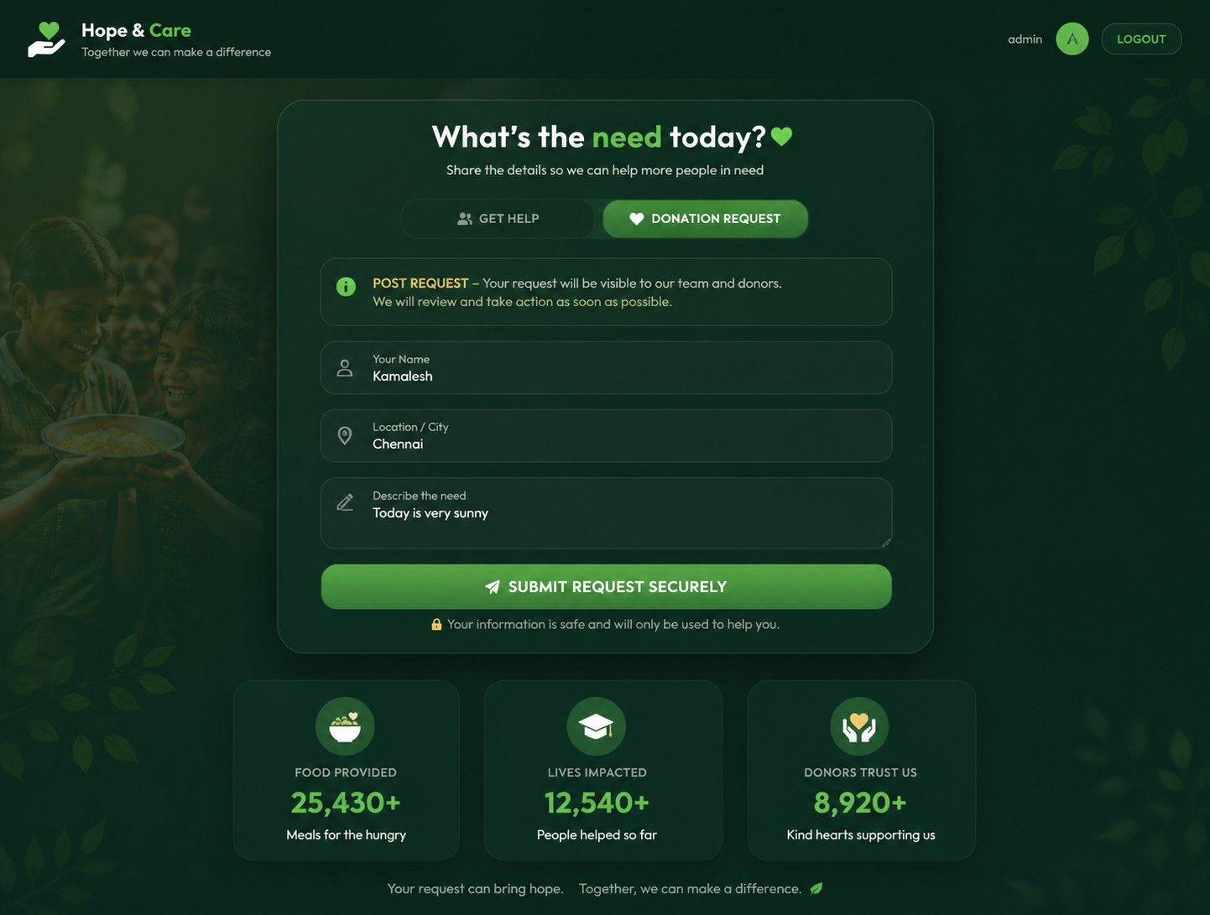
OUTPUT:

Slide 4
RESULT
A Java Servlet application was successfully implemented to demonstrate session tracking using HttpSession. The application effectively maintained user data across different web pages within the Weather Information portal.

